Slide 1

Kale Group of Industries
Quality Culture. Global Future.

Slide 2




SAMSUNG INDIA ELECTRONICS PVT LTD ( CHENNAI )
Month | Jan-24 | Feb-24 | Mar-24 | Apr-24 | May-24 | Jun-24 | Jul-24 | Aug-24 | Sep-24 | Oct-24 | Nov-24 | Dec-24 | CUMM
Sale Qty | 213018 | 278499
Rej Qty | 13 | 17
Rej PPM | 61 | 61 | 76
Target | 94 | 94 | 94

Slide 3
SAMSUNG INDIA ELECTRONICS PVT LTD ( NOIDA )
Month | Jan-24 | Feb-24 | Mar-24 | Apr-24 | May-24 | Jun-24 | Jul-24 | Aug-24 | Sep-24 | Oct-24 | Nov-24 | Dec-24 | CUMM
Sale Qty | 6240 | 7110 | 6690
Rej Qty | 00 | 00 | 00
Rej PPM | 00 | 00 | 00
Target | 341 | 341

Slide 4

GODREJ & BOYCE MFG.CO.LTD -MOHALI
Target line
Month | Jan-24 | Feb-24 | Mar-24 | Apr-24 | May-24 | Jun-24 | Jul-24 | Aug-24 | Sep-24 | Oct-24 | Nov-24 | Dec-24 | CUMM
Sale Qty | 6930 | 3720
Rej Qty | 00 | 00
Rej PPM | 00 | 00
Target | 100 | 100 | 100 | 100 | 100 | 100 | 100 | 100 | 100 | 100 | 100 | 100

Slide 5
GODREJ & BOYCE MFG.CO.LTD -SHIRWAL
Target line
Month | Jan-24 | Feb-24 | Mar-24 | Apr-24 | May-24 | Jun-24 | Jul-24 | Aug-24 | Sep-24 | Oct-24 | Nov-24 | Dec-24 | CUMM
Sale Qty | 16704 | 30945
Rej Qty | 00 | 00
Rej PPM | 00 | 00
Target | 100 | 100 | 100 | 100 | 100 | 100 | 100 | 100 | 100 | 100 | 100 | 100

Slide 6

LG
LG ELECTRONICS
Month wise PPM
Month | Jan-24 | Feb-24 | Mar-24 | Apr-24 | May-24 | Jun-24 | Jul-24 | Aug-24 | Sep-24 | Oct-24 | Nov-24 | Dec-24 | CUMM
Sale Qty | 31512 | 39824 | 48889
Rej Qty | 00 | 00 | 00
Rej PPM | 00 | 00 | 00
Target | 50 | 50 | 50 | 50 | 50 | 50 | 50 | 50 | 50 | 50 | 50 | 50

Slide 7

WHIRLPOOL OF INDIA LTD (PUNE )
Target line
Month | Jan-24 | Feb-24 | Mar-24 | Apr-24 | May-24 | Jun-24 | Jul-24 | Aug-24 | Sep-24 | Oct-24 | Nov-24 | Dec-24 | CUMM
Sale Qty | 64244 | 69870 | 59954
Rej Qty | 00 | 00 | 00
Rej PPM | 00 | 00 | 00
Target | 100 | 100 | 100 | 100 | 100 | 100 | 100 | 100 | 100 | 100 | 100 | 100

Slide 8

PANASONIC INDIA (JHAJJAR)
Target line
Month | Jan-24 | Feb-24 | Mar-24 | Apr-24 | May-24 | Jun-24 | Jul-24 | Aug-24 | Sep-24 | Oct-24 | Nov-24 | Dec-24 | CUMM
Sale Qty | 5010 | 3030 | 00
Rej Qty | 00 | 00 | 00
Rej PPM | 00 | 00 | 00
Target | 100 | 100 | 100 | 100 | 100 | 100 | 100 | 100 | 100 | 100 | 100 | 100

Slide 9

VOLT BEKO HOME APPLIANCES PVT LTD .
Month | Jan-24 | Feb-24 | Mar-24 | Apr-24 | May-24 | Jun-24 | Jul-24 | Aug-24 | Sep-24 | Oct-24 | Nov-24 | Dec-24 | CUMM
Sale Qty | 11560 | 10640 | 11555
Rej Qty | 00 | 00 | 00
Rej PPM | 00 | 00 | 00
Target | 70 | 70 | 70 | 70 | 70 | 70 | 70 | 70 | 70 | 70 | 70 | 70

Slide 10

VOLTAS LIMITED
Month | Jan-24 | Feb-24 | Mar-24 | Apr-24 | May-24 | Jun-24 | Jul-24 | Aug-24 | Sep-24 | Oct-24 | Nov-24 | Dec-24 | CUMM
Sale Qty | 4160 | 3280 | 6000
Rej Qty | 00 | 00 | 00
Rej PPM | 00 | 00 | 00
Target | 100 | 100 | 100 | 100 | 100 | 100 | 100 | 100 | 100 | 100 | 100 | 100

Slide 11
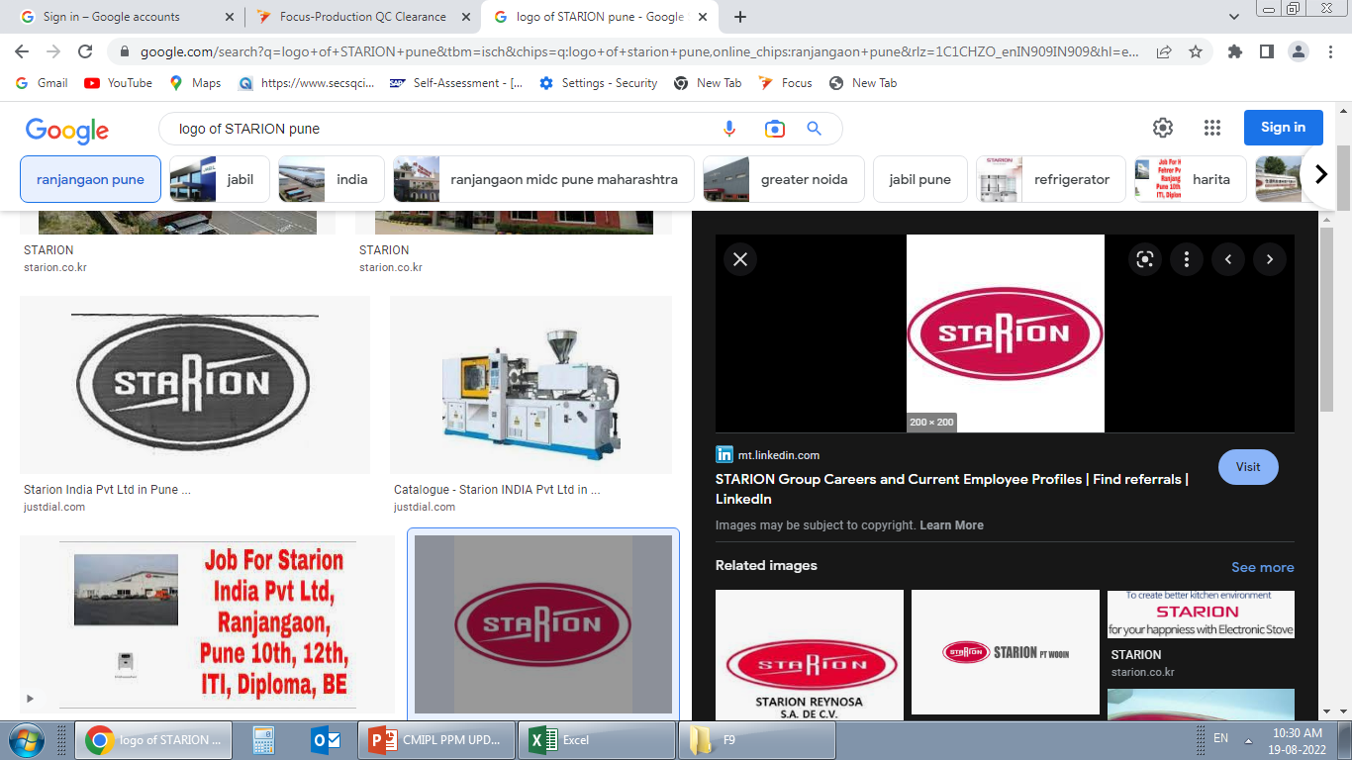
STARION INDIA PVT LTD
Month | Jan-24 | Feb-24 | Mar-24 | Apr-24 | May-24 | Jun-24 | Jul-24 | Aug-24 | Sep-24 | Oct-24 | Nov-24 | Dec-24 | CUMM
Sale Qty | 42619 | 2100 | 00
Rej Qty | 00 | 00 | 00
Rej PPM | 00 | 00 | 00
Target | 100 | 100 | 100 | 100 | 100 | 100 | 100 | 100 | 100 | 100 | 100 | 100

Slide 12
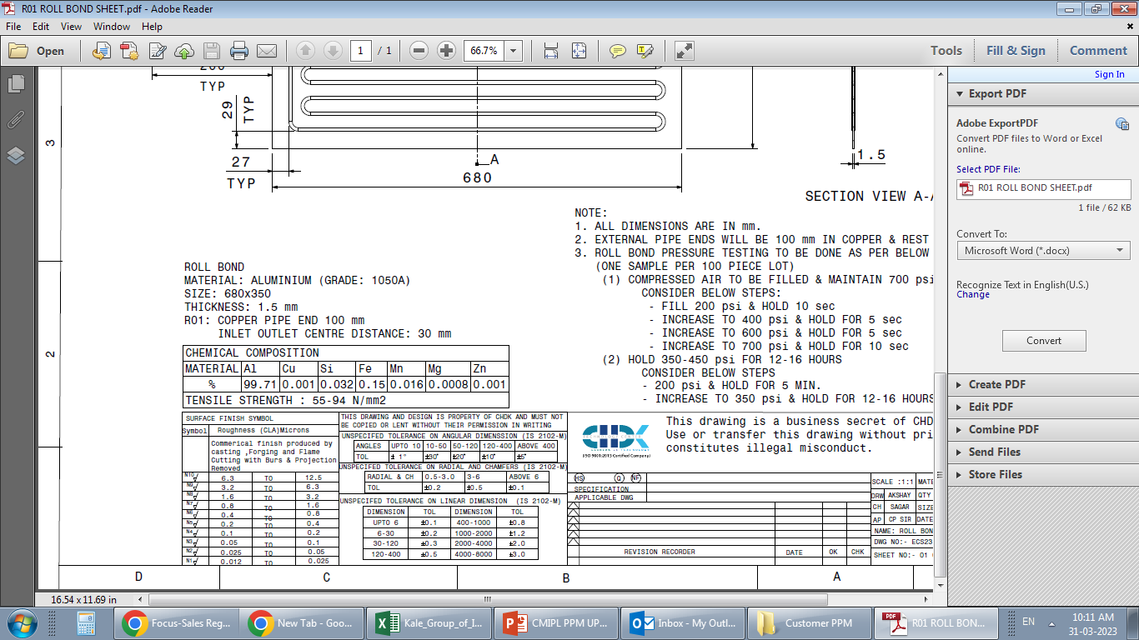
CHDK TECHNOLOGY CENTER
Target line
Month | Jan-24 | Feb-24 | Mar-24 | Apr-24 | May-24 | Jun-24 | Jul-24 | Aug-24 | Sep-24 | Oct-24 | Nov-24 | Dec-24 | CUMM
Sale Qty | 600 | 00 | 660
Rej Qty | 00 | 00 | 00
Rej PPM | 00 | 00 | 00
Target | 100 | 100 | 100 | 100 | 100 | 100 | 100 | 100 | 100 | 100 | 100 | 100

Slide 13
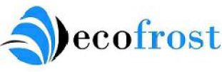
ECOFROST TECHNOLOGIES PVT. LTD
Target line
Month | Jan-24 | Feb-24 | Mar-24 | Apr-24 | May-24 | Jun-24 | Jul-24 | Aug-24 | Sep-24 | Oct-24 | Nov-24 | Dec-24 | CUMM
Sale Qty | 500 | 00 | 10
Rej Qty | 00 | 00 | 00
Rej PPM | 00 | 00 | 00
Target | 100 | 100 | 100 | 100 | 100 | 100 | 100 | 100 | 100 | 100 | 100 | 100

Slide 14

BSH
Month | Jan-24 | Feb-24 | Mar-24 | Apr-24 | May-24 | Jun-24 | Jul-24 | Aug-24 | Sep-24 | Oct-24 | Nov-24 | Dec-24 | CUMM
Sale Qty | 4608 | 00 | 3840
Rej Qty | 00 | 00 | 00
Rej PPM | 00 | 00 | 00
Target | 100 | 100 | 100 | 100 | 100 | 100 | 100 | 100 | 100 | 100 | 100 | 100

Slide 15
LG
LGE NOIDA
Month | Jan-24 | Feb-24 | Mar-24 | Apr-24 | May-24 | Jun-24 | Jul-24 | Aug-24 | Sep-24 | Oct-24 | Nov-24 | Dec-24 | CUMM
Sale Qty | 200 | 00 | 00
Rej Qty | 00 | 00 | 00
Rej PPM | 00 | 00 | 00
Target | 100 | 100 | 100 | 100 | 100 | 100 | 100 | 100 | 100 | 100 | 100 | 100

Slide 16


Slide 17
INHOUSE PPM-2024

Slide 18
PAINT SHOP : MONTHLY INWARD REJ TREND -2024

Slide 19
PAINT SHOP : MONTHLY O S & D TREND -2024

Slide 20
PAINT SHOP : MONTHLY REJECTION REPORT -2024

Slide 21
PAINT SHOP : MONTHLY REWORK TREND -2024

Slide 22
PAINT SHOP : MONTHLY N2 INSPECTION REPORT -2024
Target line

Slide 23
PAINT SHOP : MONTHLY OQC TREND-2024
PAST
PRSENT
Target line

Slide 24
PAINT SHOP : MONTHLY DC IHR TREND -2024

Slide 25
PAINT SHOP : MONTHLY COPQ -2024

Slide 26
CMIPL : Customer Complaints Trend -2024
Target line
CUSTOMER COMPLAINTS MATRIX
Sr. no | Month / Customer | Jan-24 | Feb-24 | Mar-24 | Apr-24 | May-24 | Jun-24 | Jul-24 | Aug-24 | Sep-24 | Oct-24 | Nov-24 | Dec-24
1 | SIEL © | 0 | 0 | 0
2 | SIEL (N) | 0 | 0 | 0
3 | Starion ltd | 0 | 0 | 0
4 | LG Electronics | 0 | 0 | 0
5 | Godrej Mohali | 0 | 0 | 0
6 | Godrej Shirwal | 0 | 1 | 0
7 | Voltas | 0 | 0 | 0
8 | Voltas Beko | 0 | 0 | 0
9 | Panasonic | 0 | 0 | 0
10 | Whirlpool | 0 | 0 | 0
11 | Eco frost Technology | 0 | 1 | 0
12 | CHDK | 0 | 0 | 0
13 | BSH | 1 | 0 | 1
14 | LG Noida | 0 | 0 | 0

